Slide 1
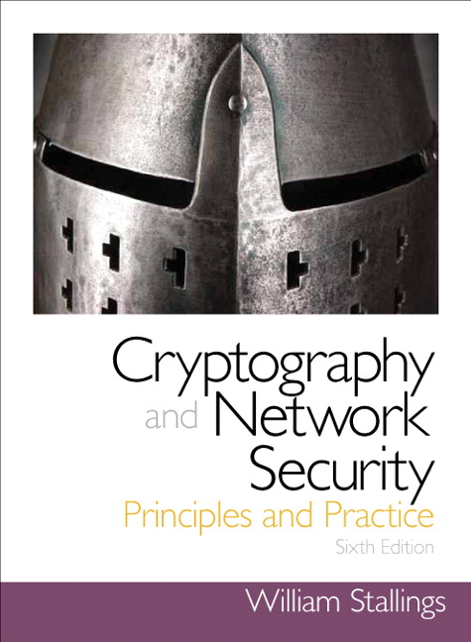
Security
Lecture 2: Threat Model
R. Brooks

Slide 2
Goal of the attacker: STRIDE
Goal
What to look at
Spoofing Identity
Tampering
Repudiation
Information Disclosure
Denial of Service
Elevation of Privileges
Authentication
Integrity
Confirmation
Confidentiality
Availability
Authorisation

Slide 3
Means of Attacker
Passive
Active
Eavesdropping
Traffic Analysis
Modification of message
Replay Attack
Masquerade
Blocking

Slide 4
Where and by whom: EINOO
Who
Where
External
Internal
Network
Offline
Online

Slide 5
Where was the mistake? TPM
Identification of THREATS were incomplete
The POLICY did not work as intended or allowed things that shouldn’t have been allowed
The MECHANISMS were circumvented

Slide 6
The power of the attacker
From weakest to strongest
Brute force
Try every key
Ciphertext-Only Attack (COA)
Attacker knows ciphertext of several messages encrypted with same key (but doesn’t know plaintext).
Possible to recover plaintext (also possible to deduce key) by looking at frequency of ciphertext letters
Known Plaintext Attack (KPA)
Attackers observes pairs of plaintext/ciphertext encrypted with same key.
Possible to deduce key and/or devise algorithm to decrypt ciphertext.
Chosen-Plaintext Attack
Attacker can choose the plaintext and look at the paired ciphertext
Attacker has more control than known-plaintext attack and may be able to gain more info about key
Chosen-ciphertext Attack
Attacker chooses ciphertexts & gets decrypted plaintext back

